Slide 1


EPIC and the Future of U.S. NWP: A View From Academia
Cliff Mass
Department of Atmospheric Sciences
University of Washington

Slide 2
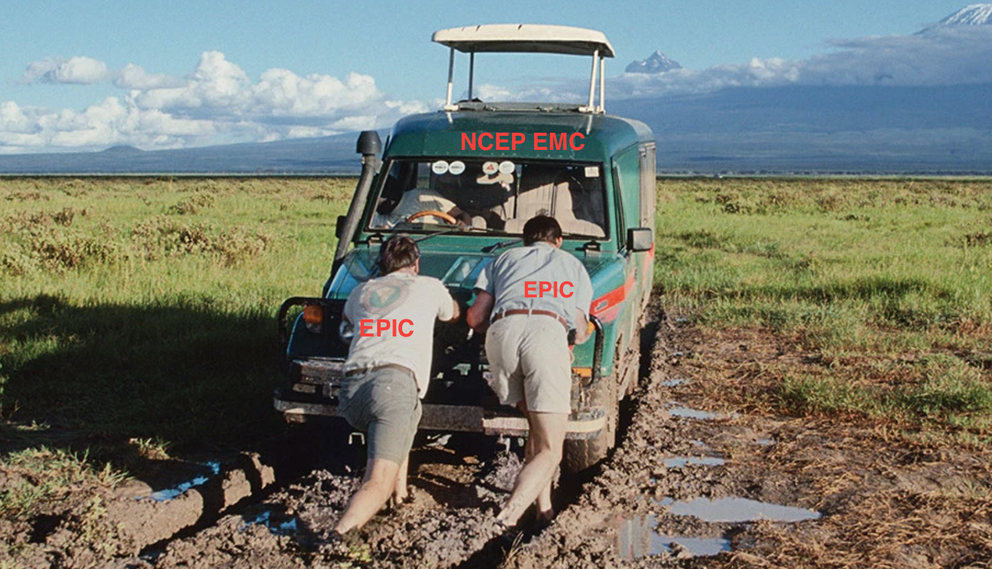
U.S. Operational Global Numerical Weather Prediction is Stuck in Mediocrity and Will Not Advance to First Tier Without Major Changes in Organization, Leadership, and Structure

Slide 3
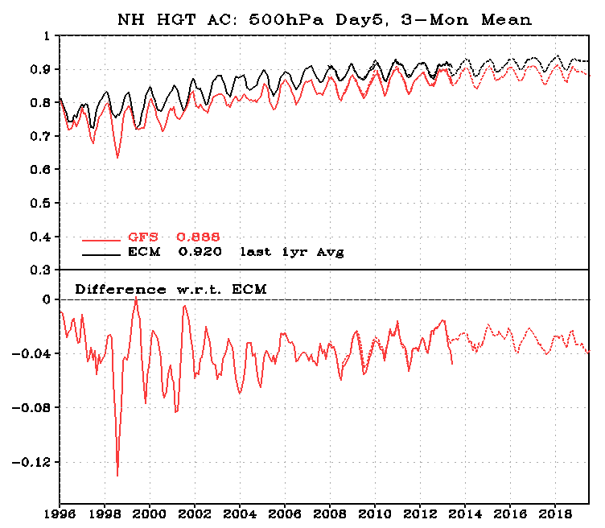
U.S. NWP Skill is Behind World Leaders and Is NOT Catching UP Even With Substantial Investments

Slide 4

With the World’s Largest Atmospheric Sciences Research Community and the Largest Global NWP Budget We Should be the Best. But we are Not.

Slide 5
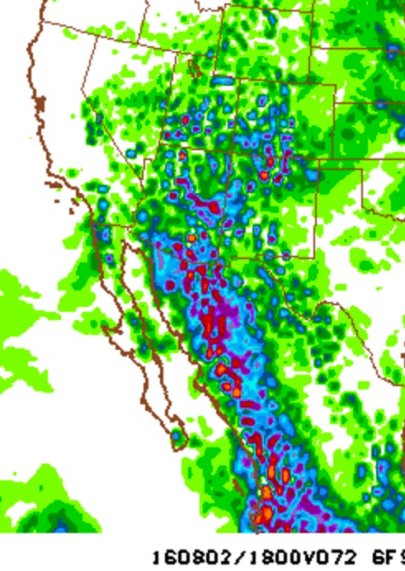
Our global model, GFS, has lagged behind the state-of-the-science in many areas, such as:
Cloud and precipitation microphysics
Convective parameterization
Resolution and size of ensembles
Data assimilation (ECMWF moved to 4DVAR decades ago)
Boundary layer parameterization
Post-processing.

Slide 6
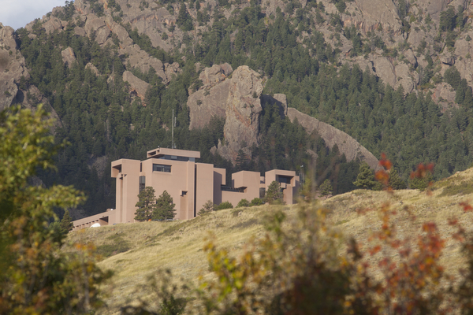

Large Impact on the Academic Community
Few academic researchers use the U.S. operational global model for research
U.S. students become familiar and contribute to other modeling systems (e.g., WRF and MPAS)
NCAR has developed global modeling systems completely independent of NOAA/NWS.
Many U.S. students see NCEP/EMC as a backwater and choose to find employment elsewhere

Slide 7

The Origin of the U.S. NWP Problem is No Secret
U.S. resources is spread over many global modeling systems (e.g., Navy NAVGEM, NCAR MPAS, NOAA FV-3/NIM/FIM, NASA GEOS, AF UKMET-Unified)
NOAA has divided responsibility for NWP over too many groups and decision makers

Slide 8

The Origin of the U.S. NWP Problem is No Secret
No coherent, detailed strategic plan
Poor use of resources (e.g., NGGPS)
NOAA not working closely with the NCAR and the academic community
No single group given the resources and responsibility to DO THIS RIGHT
Excellence is not a priority

Slide 9
The Situation Has Not Gotten Better with NGGPS and FV-3
FV-3 is a better model than GFS but…..
FV-3 is poorly documented and without a complete GITHUB release
Little support or documentation
No plans to make it a real community model.
NCEP staff have not mastered it themselves.
Without an improved data assimilation system will hardly move the needle in improving forecast skill.

Slide 10

The Result are In: FV-3 Fails the Graduate Student Test

Slide 11

Our Community Have Been Given One LAST Chance Before the NOAA Operational Global NWP Becomes Irrelevant

Slide 12
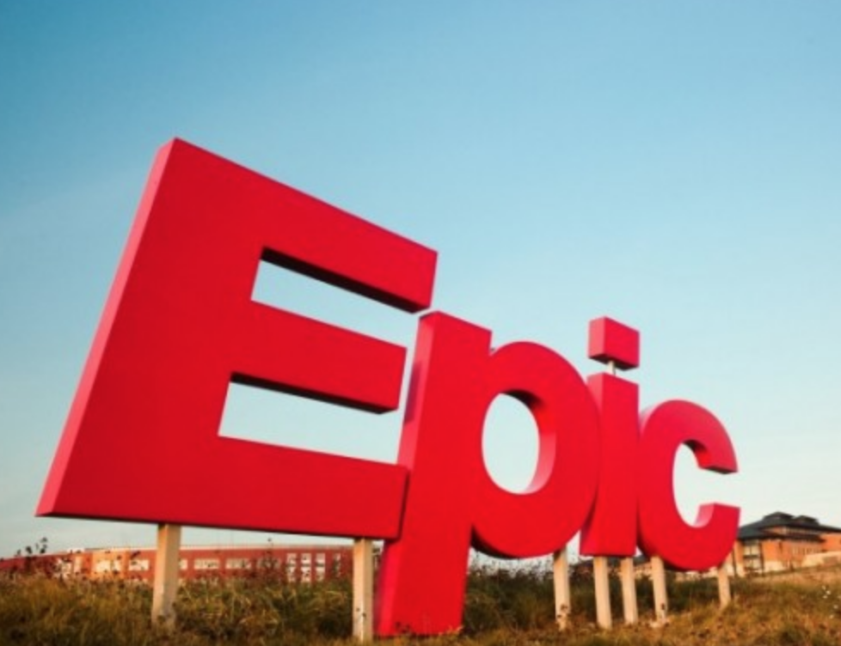

Slide 13

The Stars Are Aligned Now for Change But if We Miss This Train, It May Never Come Again in our Lifetime

Slide 14
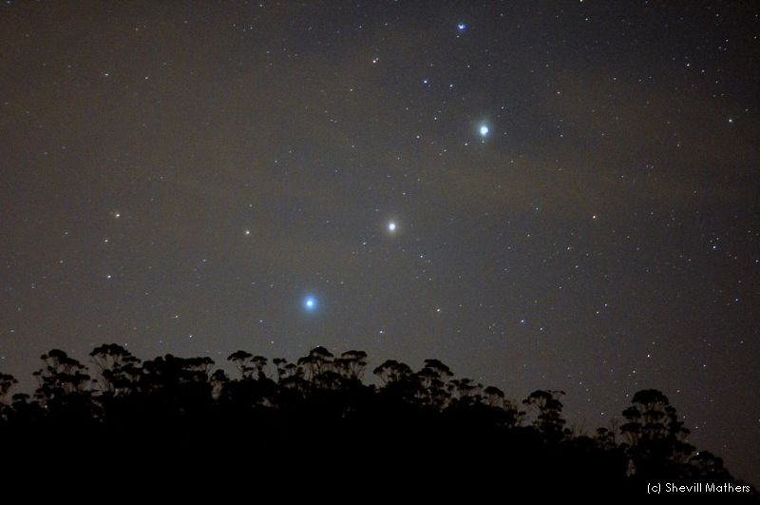
The Stars Are Aligned
NOAA leadership understands the problem and wants to fix it
Both the head of NOAA and the president’s science advisor are modelers.
The nation and Congress know the problem and are ready to invest in fixing it

Slide 15
The Stars Are Aligned
Congress passed a Weather Bill with resources and detailed guidance on how to fix U.S. NWP
Tensions between NOAA Labs and NCEP/EMC have faded.
The private sector is demanding improvement.
We are having this meeting.

Slide 16

Only by complete reorganization of how we develop, test, and improve the national global modeling system can U.S. operational NWP regain world leadership

Slide 17

Such reorganization will require more cooperation and concentration of effort

Slide 18

A Properly Structured EPIC Center Could Go Far in Addressing the Problem
It would be the centerpiece of NOAA global model development
Provide coherent organization and leadership structure
Must include active participation of NCAR and ESRL
Should probably be in Boulder
It would develop and SUPPORT a community global modeling system for all spatial scales
Hopefully, NASA and DOD would join the effort.

Slide 19
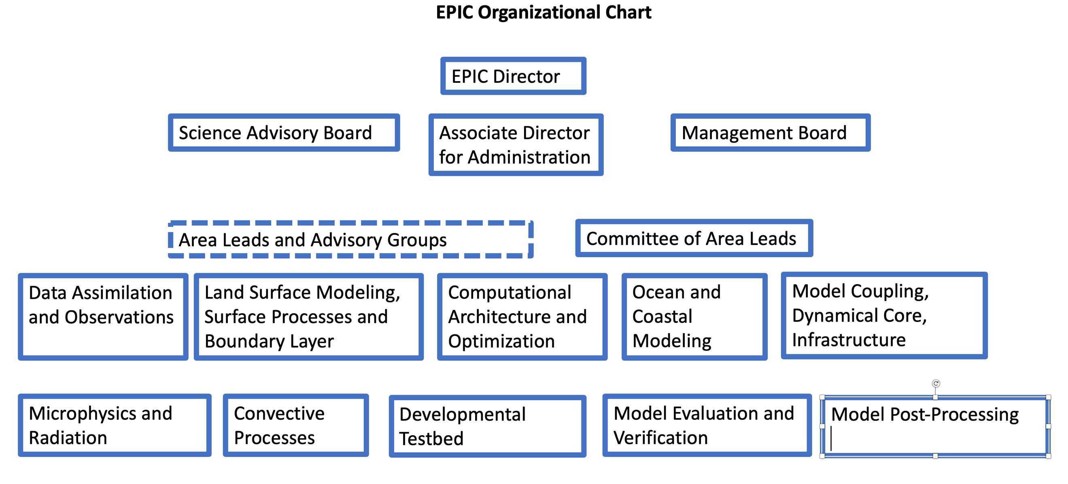
How EPIC Might Be Organized

Slide 20
More Details
Excellence and world leadership must be the unquestioned goals.
Must be seen as a national system, not a NOAA system, supporting BOTH the operational and research communities.
A specific strategic plan is required as well as implementation plans.
Should be led by a well-known intellectual leader of the field and guided by an expert advisory board.
EPIC should be established outside of NOAA, in a location attractive to visitors. A vibrant development center with an active seminar series and attractive visitor positions.

Slide 21
Even More Details
The new NWP center, while enjoying foundational funding through NOAA, will acquire funding from a range of private sector and Federal sources.
The new center must support the development of an easily mastered testbed and development system.
The new center will have the control of funds for an external grants program for research and development THAT DIRECTLY ADDRESS key needs for the new center.
The new EPIC center should contain experts that will lead efforts in each key area of global NWP.

Slide 22


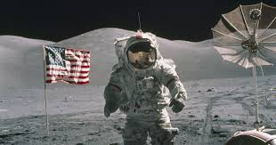
The EPIC effort could reflect some of the nation’s great science successes--all when we worked together:

Slide 23
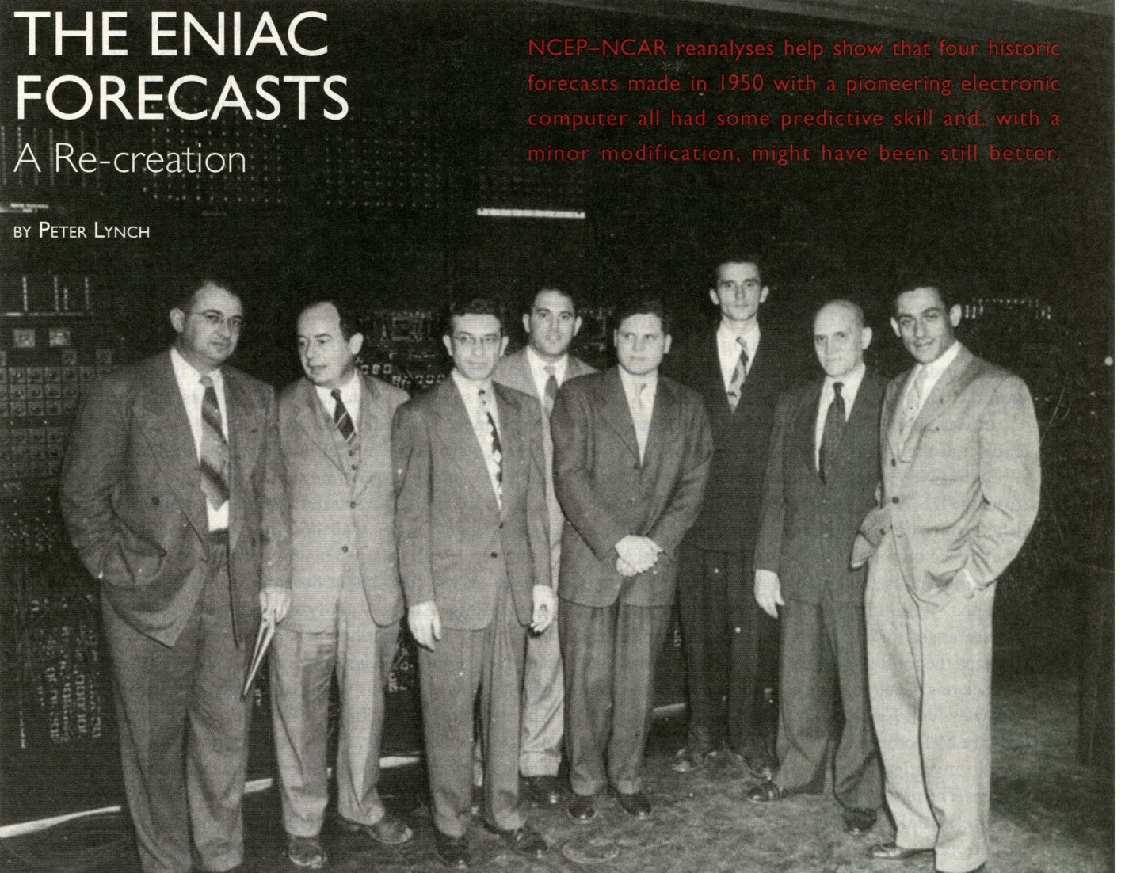
And the early days of NWP, when the U.S. was well ahead of the rest of the world

Slide 24
The End

